Slide 1
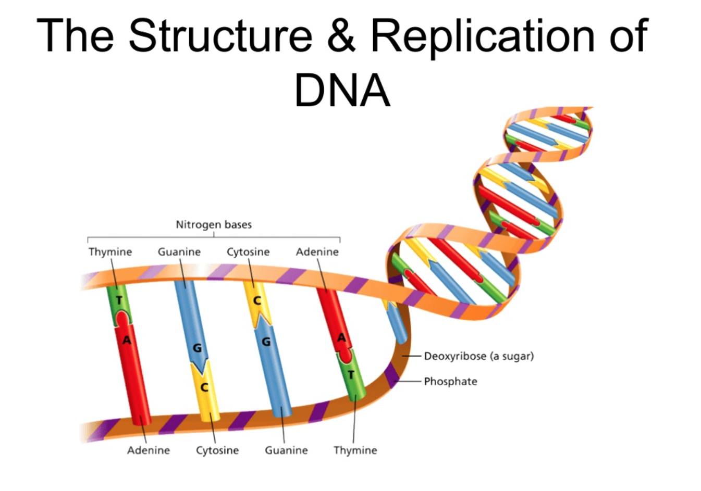
BIO*300/CMPSC*300 – SPRING 2016
CRASH COURSE IN MOLECULAR BIOLOGY

Slide 2
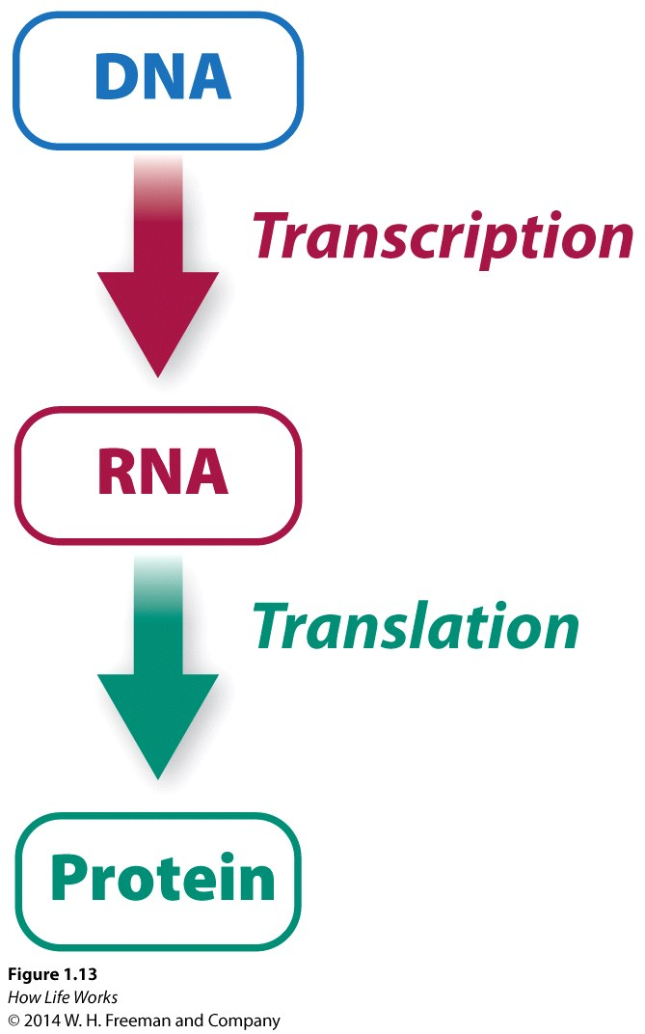
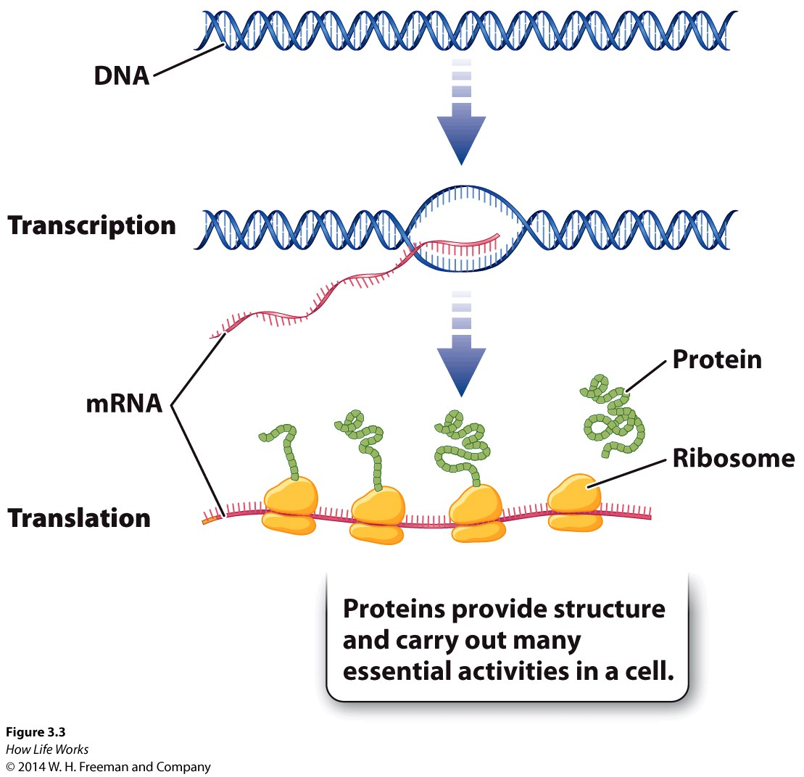
The Central Dogma of Molecular Biology

Slide 3
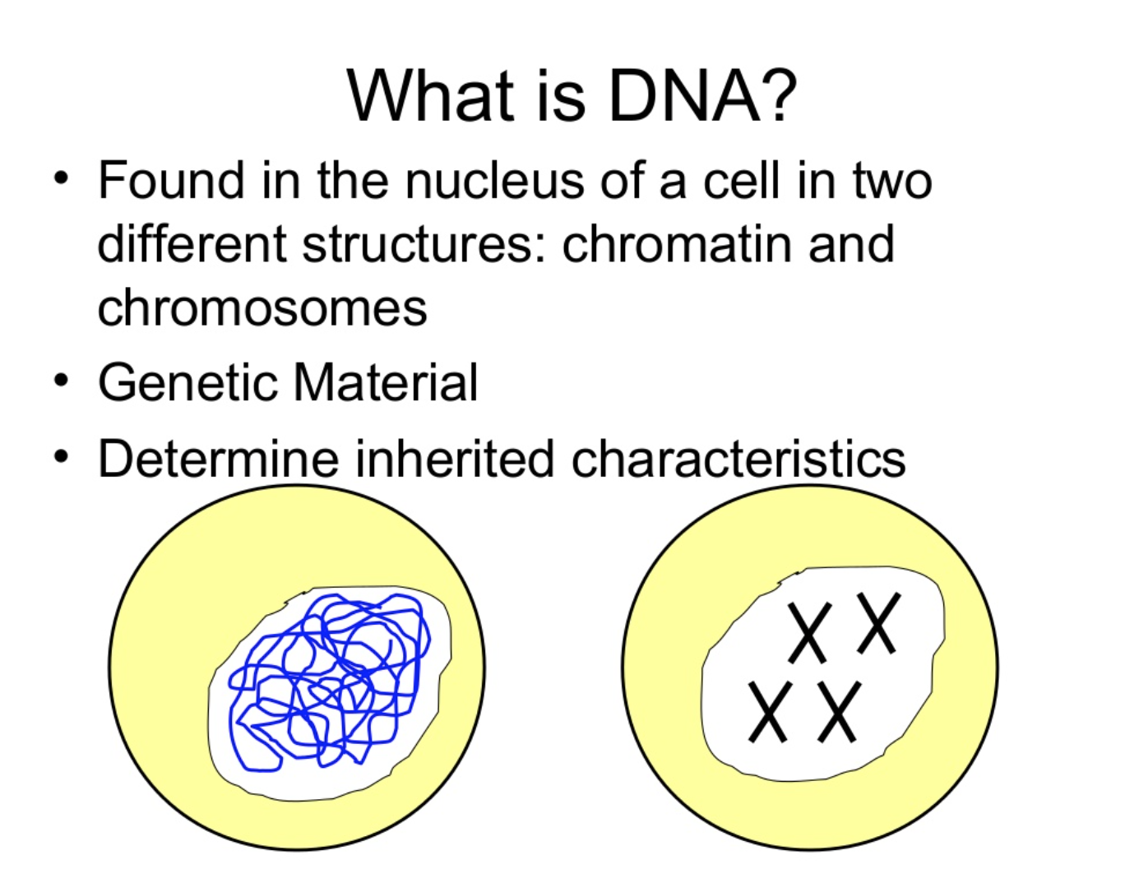

Slide 4
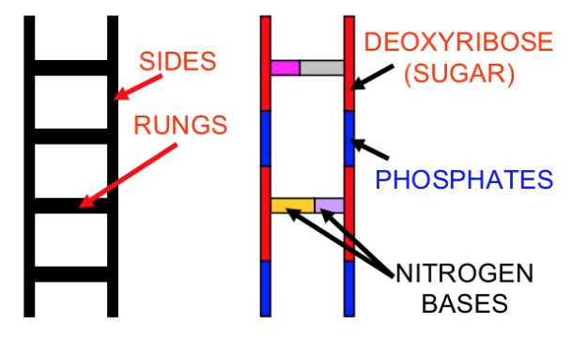
DNA Structure
Looks like a twisted ladder
Two sides of the ladder
Sugar (deoxyribose)
Phosphates
Alternating
Rungs of the ladder
Nitrogenous bases

Slide 5
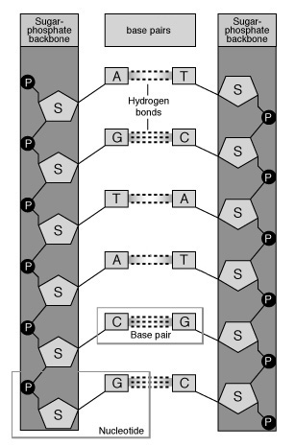
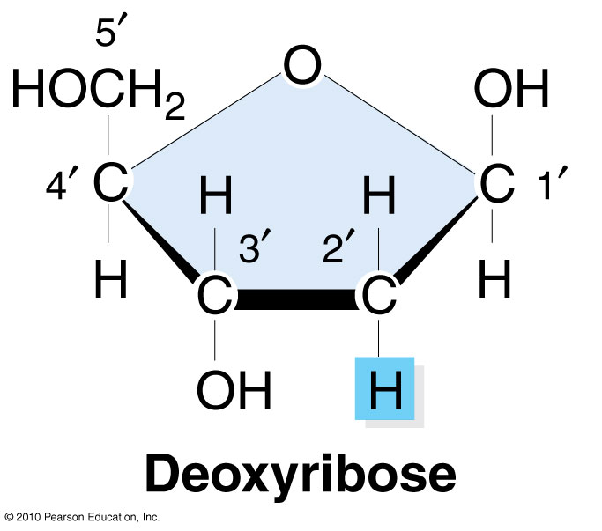
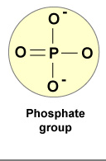
DNA Structure
Deoxyribose sugar
Phosphate

Slide 6
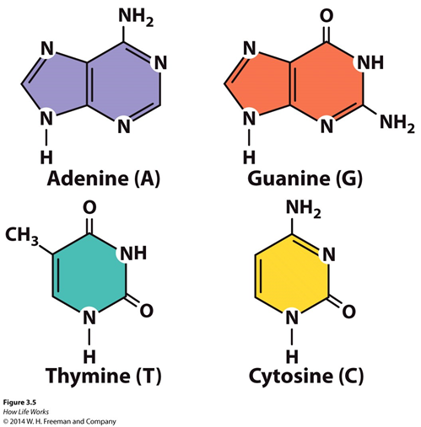
DNA Structure
Nitrogenous Bases

Slide 7
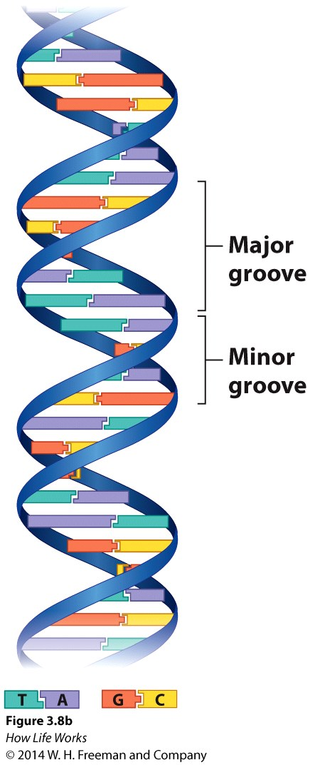
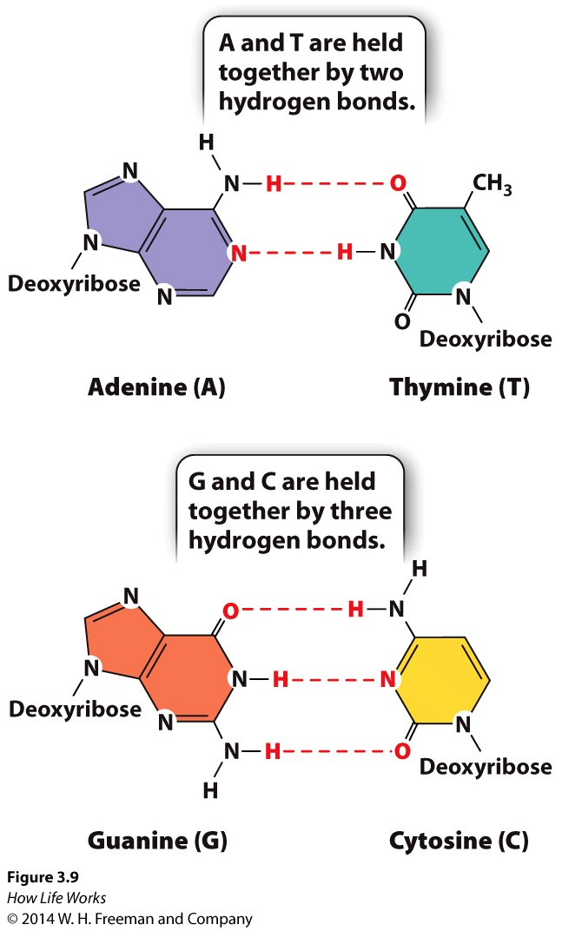
How Do Nitrogenous Bases Pair?
Specific
Preserves distance between backbones
Hydrogen bonds
Key to replication
Purines and pyrimidines

Slide 8
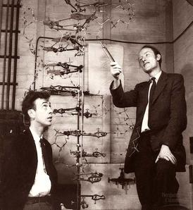
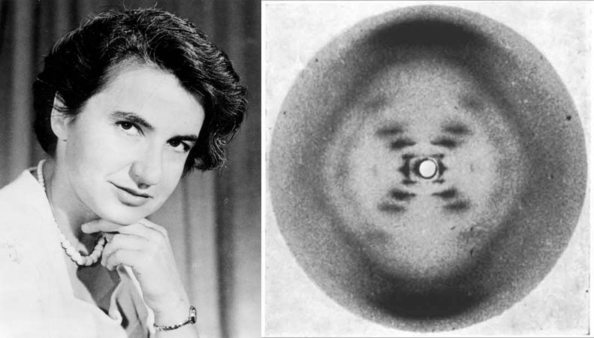
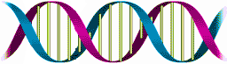
DNA Double Helix - A Twisted Ladder
Watson and Crick, 1953
Rosalind Franklin

Slide 9
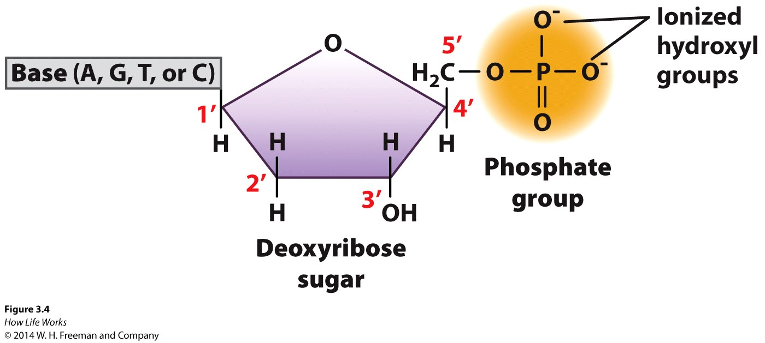
Nucleotide Structure
One sugar
One phosphate group
One base

Slide 10
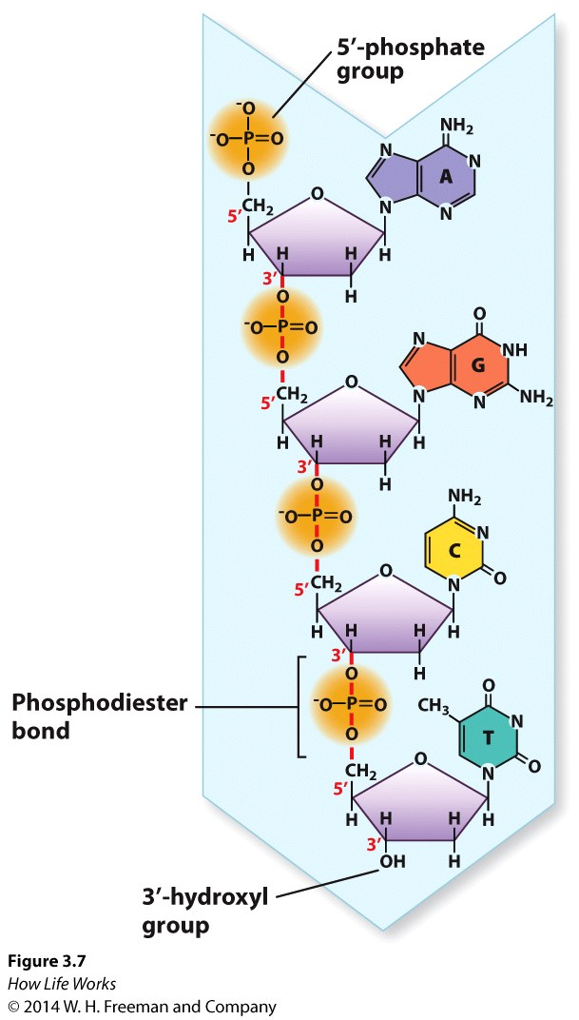
Structure of DNA
Nucleotides are joined by phosphodiester bonds
phosphate to sugar
covalent bonds
Polarity
5’ end – phosphate group
3’ end – hydroxyl group
DNA created in 5’ -> 3’ direction

Slide 11
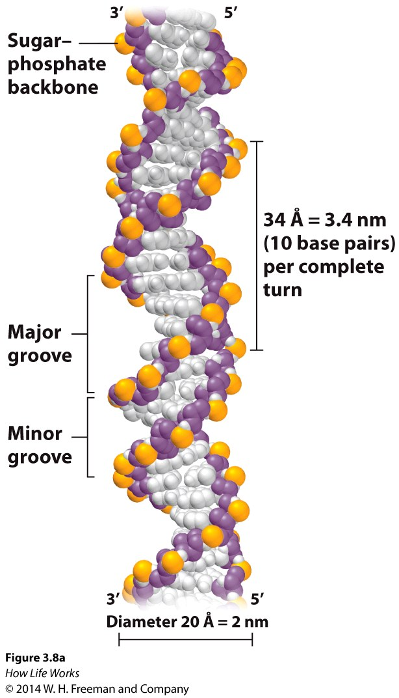
Structure of DNA
Double-stranded
Diameter – 2nm
Helix
Complete turn = 10bp, 3.4nm
Major groove
Minor groove

Slide 12
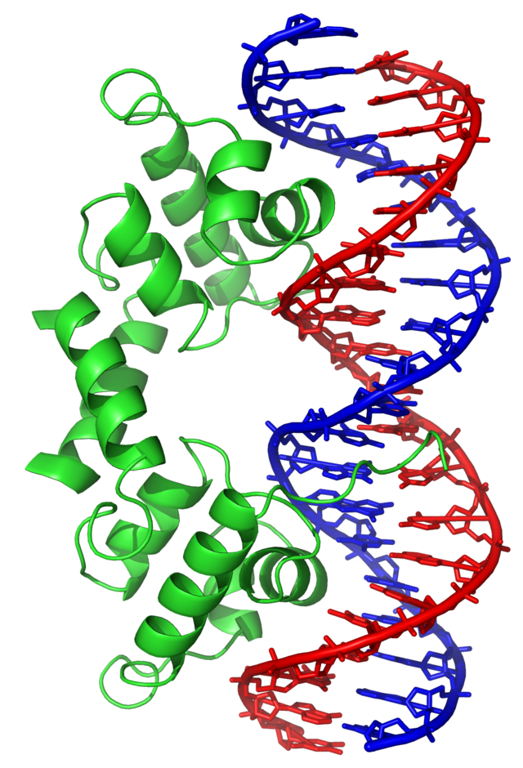
Structure of DNA
Double-stranded
Diameter – 2nm
Helix
Complete turn = 10bp, 3.4nm
Major groove
Minor groove

Slide 13
Structure of DNA
Antiparallel
5’ -> 3’
3’ -> 5’

Slide 14
DNA Replication Process
The two sides of the parent molecule unwind/unzip
Daughter strands are synthesized using parent strands as templates
Parent/daughter duplex winds back together
Semi-conservative

Slide 15
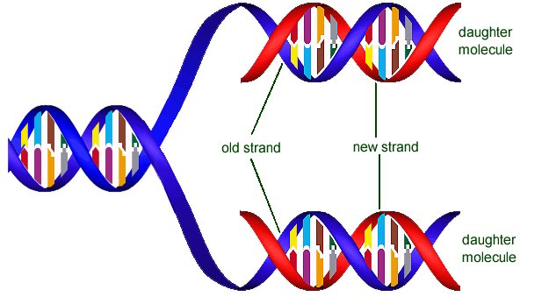
DNA Replication Process

Slide 16

DNA Replication Process http://www.hhmi.org/biointeractive/dna-replication-schematic

Slide 17
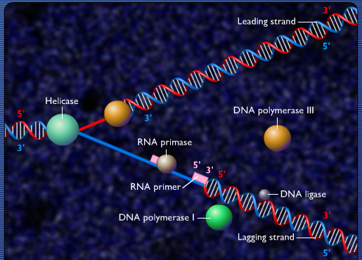
DNA Replication Enzymology
http://highered.mheducation.com/sites/0073525324/student_view0/chapter20/dna_replication_fork.html

Slide 18
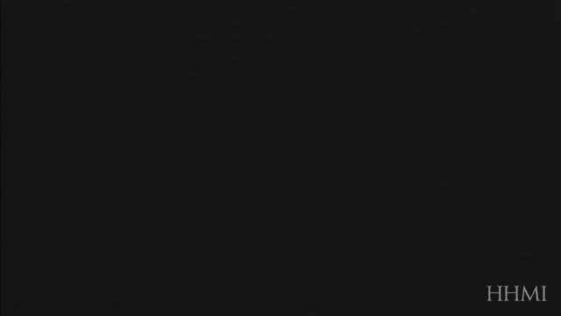
DNA Replication Enzymology http://www.hhmi.org/biointeractive/dna-replication-basic-detail

Slide 19
Review Question 1
In the DNA sequence 5'–TGAC–3', the phosphodiester linkage between the guanine and the adenine connects:
A. the 3' end of the guanine to the 5' end of the adenine.
B. the 2' end of the adenine to the 3' end of the guanine.
C. the 5' end of the guanine to the 1' end of the adenine.
D. the 3' end of the adenine to the 5' end of the guanine.
E. the 5' end of the guanine to the 2' end of the adenine.

Slide 20
Review Question 1
In the DNA sequence 5'–TGAC–3', the phosphodiester linkage between the guanine and the adenine connects:
A. the 3' end of the guanine to the 5' end of the adenine.
B. the 2' end of the adenine to the 3' end of the guanine.
C. the 5' end of the guanine to the 1' end of the adenine.
D. the 3' end of the adenine to the 5' end of the guanine.
E. the 5' end of the guanine to the 2' end of the adenine.

Slide 21
Review Question 2
In the DNA of certain bacterial cells, 16% of the nucleotides are adenine. What are the percentages of the other nucleotides in the bacterial DNA?
A. 34% thymidine, 34% guanine, 16% cytosine
B. 34% uracil, 16% guanine, 16% cytosine
C. 16% thymidine, 34% guanine, 34% cytosine
D. 34% thymidine, 16% guanine, 34% cytosine

Slide 22
Review Question 2
In the DNA of certain bacterial cells, 16% of the nucleotides are adenine. What are the percentages of the other nucleotides in the bacterial DNA?
A. 34% thymidine, 34% guanine, 16% cytosine
B. 34% uracil, 16% guanine, 16% cytosine
C. 16% thymidine, 34% guanine, 34% cytosine
D. 34% thymidine, 16% guanine, 34% cytosine

Slide 23
Review Question 3
DNA replicates in a semi-conservative manner. This means
one daughter strand is synthesized as a large fragment while the other is synthesized in smaller fragments, both in the 5’-3’ direction
every newly formed double-stranded DNA molecule consists of one parental strand and one daughter strand
every newly formed double-stranded DNA molecule is comprised of two new daughter strands
one daughter strand is synthesized as a large fragment in the 5’-3’ direction while the other is synthesized in smaller fragments in the 3’-5’ direction

Slide 24
Review Question 3
DNA replicates in a semi-conservative manner. This means
one daughter strand is synthesized as a large fragment while the other is synthesized in smaller fragments, both in the 5’-3’ direction
every newly formed double-stranded DNA molecule consists of one parental strand and one daughter strand
every newly formed double-stranded DNA molecule is comprised of two new daughter strands
one daughter strand is synthesized as a large fragment in the 5’-3’ direction while the other is synthesized in smaller fragments in the 3’-5’ direction

Slide 25
Review Question 3
DNA replicates in a semi-conservative manner. This means
every newly formed double-stranded DNA molecule consists of one parental strand and one daughter

Slide 26
Supporting Videos
The DNA Double Helix (17 mins)
http://media.hhmi.org/biointeractive/films/Double_Helix.html
The Chemical Structure of DNA (3 mins)
http://www.hhmi.org/biointeractive/chemical-structure-dna

